Slide 1

Re-imagining Hiscox IT: A DevOps story
Jonathan Fletcher

Slide 2





Me
Jonathan Fletcher
Architect in Hiscox Group IT since 2012
Ex Dev
Ex Ops
http://enterprisedevops.blogspot.com
http://www.devops.com
@FletcherJofanon
jonathan.fletcher@hiscox.com

Slide 3
Who are Hiscox?
International specialist insurer
£2.0B in GWP
2,000 employees
UK
Birmingham
Colchester
Glasgow
Leeds
London
Maidenhead
Manchester
York
Guernsey
St Peter Port
Europe
Amsterdam
Bordeaux
Brussels
Cologne
Dublin
Hamburg
Lisbon
Lyon
Madrid
Munich
Paris
USA
Atlanta
Chicago
Los Angeles
New York City
San Francisco
White Plains
Bermuda
Hamilton
Latin American
gateway
Miami
Asia
Bangkok Hong Kong
Singapore

Slide 4
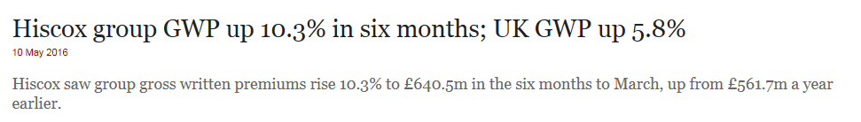
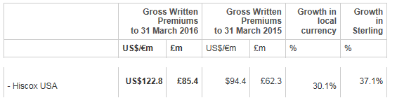
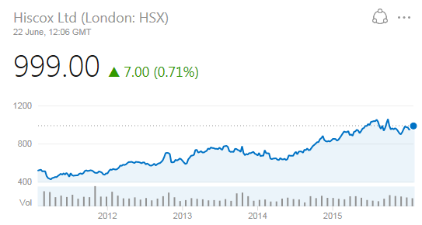
Challenges (opportunities)
Robert Hiscox quote
I bore my colleagues that we should be an IT company with insurance attached

Slide 5
IT strategy findings – what are the business telling us?
We need to increase our speed to market
We need an increased our pace of change
We need predictable and reliable change
Mis-aligned team objectives are hindering delivery and ownership

Slide 6
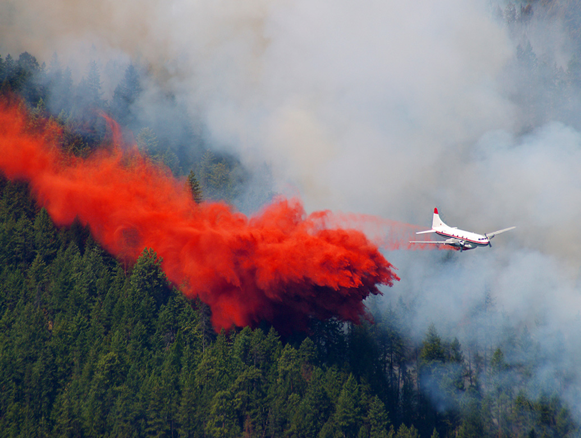
The journey of DevOps at Hiscox

Slide 7

Let’s start our journey in the Shire

Slide 8

Je suis Frodo
Started as a Solution Architect in 2012
Generally frustrated – why is everything so slow and expensive?
Frustration led to ~1m PowerPoints in 2012 influencing IT Director (now CIO) & Head of Arch (now CTO)
Proposed 3 things to start: 1. IT re-org 2. Technical leadership 3. Investment in automation
What started out as an ambition to increase the pace of change has evolved into “rebooting” the IT team

Slide 9
Hiscox yesterday (ish)
UK
London Markets
US
Europe
Bermuda
IT capability
Group development
Group support
Group infrastructure
Group testing
Group DBA
Group release and deployment
Group architecture

Slide 10
Hiscox today (ish)
Dev
Dev
Dev
Dev
Dev
Support
Support
Support
Support
Support
UK
London market
USA
Europe
Bermuda
Testing
Testing
Testing
Testing
Testing
Infrastructure
Platform Services
Architecture
Architecture
Architecture
Architecture
Architecture

Slide 11
Platform Services (or the evil “DevOps team”)
As we’ve seen the growth of the business is challenging IT to find new and better ways to do things
Means worker smarter not harder. Doesn’t mean an ever increasing head count
Platform Services helps break down silo’s between teams by providing a change platform that is re-usable between multiple teams
Help others use the platform (they don’t implement themselves!)

Slide 12


Be careful...
You don’t solve a silo issue by creating another silo! BAD
Having a team that evangelises DevOps ideas, concepts and tooling is GOOD
Notes:
Jarjar – Phantom Menace
Empire strikes back - Hoth

Slide 13



















Core platform capabilities
Source code management
Artefact management
Automated application deployment
Automated server configuration
Load performance test
Automated functional test
Continuous Integration and automated code build
Application Performance Management
Agile planning
Defect management
More...
Notes:
If it has a silly name we own it

Slide 14
Our first project – Da Vinci
On our new UK Home insurance platform we changed everything:
Policy administration, claims, billing and collection systems
Websites
Product and underwriting, business processes
Vendors
Mixed of COTS products, Java, SQL Server and Windows
Myself and my team came late to the party with DevOps thinking
Manual testing, manual deployments, throw it over the wall behaviour from vendors but also our internal teams
No real thinking about how to transition from “project” mode to “BAU” mode
Why start here? Everyone says start small with DevOps - but this is the biggest change program Hiscox has ever done.
Couldn’t think of any other way!

Slide 15



A new breed of Hiscox teams
Create teams of “purple people”. They are not “blue” of the business or “red” of the technology, but a blend of the two, hence purple.

Slide 16

The new Hiscox team methodology – purple teams
Autonomous
Cross skilled
Cradle to grave responsibilities
Aligned to a business unit
Consists of all the people you need to make changes
Shared goals & incentives

Slide 17
Deployment automation before and after
Before | After
Team of 8 people involved in a release | Max 2 people involved in a release
~2 deploys a week | ~ 50 deploys a day
3-4 hours deployment time | 20 minutes deployment time
Only 5 environments | 31 environments

Slide 18
Automation Benefits
 | Staff needed | Time taken / release | Cost / release
Manual Release | 8 | 3 hours | £1,650
Automated Release | 2 | 20 minutes | £45
Reduction |  | 89% | 97%
2016 | Jan | Feb | Mar | Apr | May | Jun | Total
Merlin | 723 | 496 | 735 | 741 | 742 | 708 | 4145
SBDP | 120 | 183 | 350 | 74 | 204 | 156 | 1087
 | 843 | 679 | 1085 | 815 | 946 | 864 | 5232

Slide 19
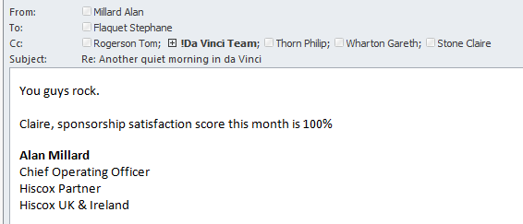
What did other people think?
2 weekly change cycle (was 6 weeks)
40% fewer IT resources (7 systems reduced to 2)
Doubled the on-line conversion rate in the first two weeks
Project
Sponsor
My
Bosses boss

Slide 20

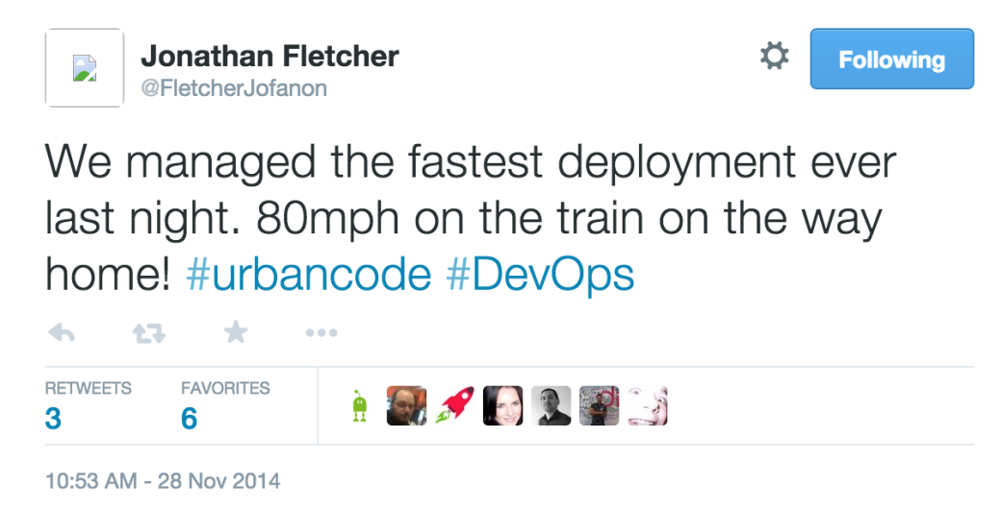
Release business value, anytime, anywhere...

Slide 21
Mistakes
I told people what their problems were rather than including them in the solution
Assumed that everyone else is like me - underestimated the difficulty and time taken to introduce cultural change
Occasionally fought fire with fire
Struggled trying to change the wings of the plane when its in the air
Started too big – tried to change everyone at the same time
We spent a lot of time influencing up when we also should have been influencing down as well
We’ve introduced large amounts of new technology and new processes. Have been frustrated on occasion how long these take to adopt

Slide 22
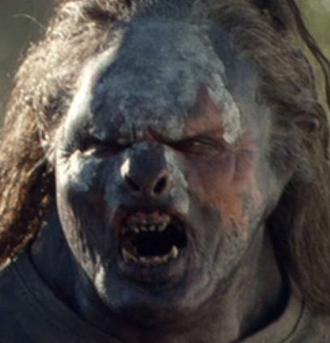
Beware the change resistors
Some people will love it and embrace it
Some people will need time
Some people will never get there and will make things difficult

Slide 23

Why put you head above the parapet?
Promotion
Visibility across all IT and the business
Increased funding in DevOps-centric projects, tooling and people
Most of all....
TRUST

Slide 24
I’m a fraud

Slide 25
We’ve done Dev...
What about poor old Ops?

Slide 26
My favourite quote
“Stop spending money on undifferentiated heavy lifting”
Dr Werner Vogels Amazon CTO

Slide 27
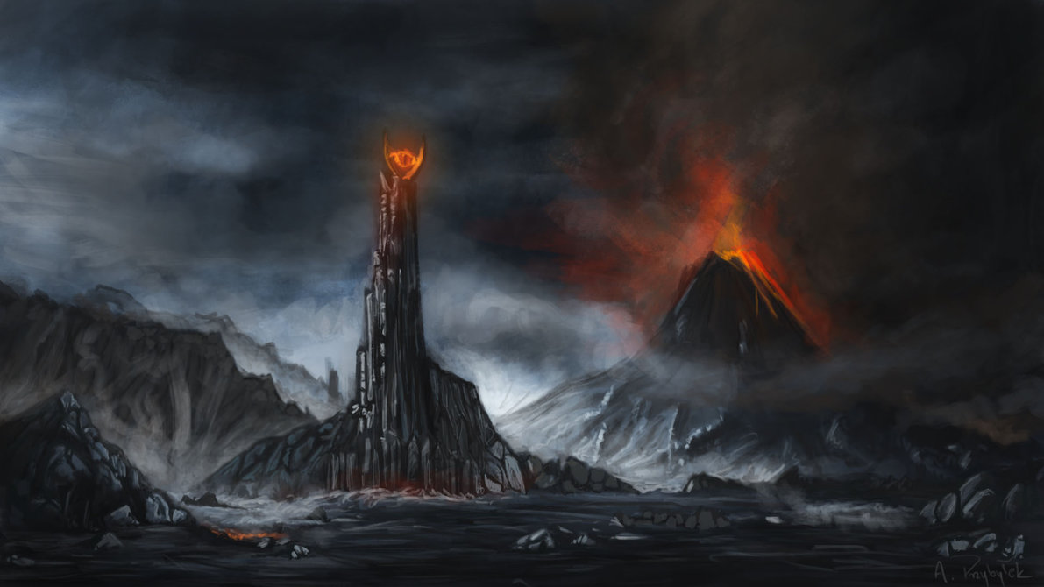

Glory lies within

Slide 28
Cloud @ Hiscox
Two clear leaders in Gartner Magic Quandrant are Microsoft and Amazon
After PoC’s in both we selected Microsoft Azure over Amazon AWS
Hiscox are primarily a Microsoft house
Passionate about PaaS over IaaS
Enterprise support feels more mature in Azure
(Hopefully) When both Dev and Ops are using the same tools, processes and are working in the same team then (hopefully) “DevOps” will happen

Slide 29
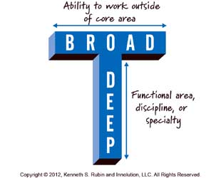

What roles are needed?
The use of Cloud & IaC changes what core skills are needed
Attitude > DevOps/automation/development > specialist infrastructure skills
To that end, talking about roles is less relevant – T shaped people
This
Not this

Slide 30

Cloud team
Azure consultant
Server
Scrum master
AD
DBA
Network
Dev Tester
Project
manager
Build & Release
Product Owner
Core team
Storage & Backup
Build & Release
Cloud Architect
Application development teams
Contributors

Slide 31
Things we have been conscious of...
Don’t move our problems in our data centre to the Cloud – lift and shift is therefore not desirable
Let Microsoft do the heavy lifting
Doing a cost comparison between hosting your own infrastructure and the Cloud is blinking hard but without it we knew we wouldn’t get anywhere
The move to Infrastructure as Code is akin to an infrastructure guy becoming a developer – a massive change in culture and skills

Slide 32
What is Infrastructure as Code?
Infrastructure is part of the application
It means writing code to manage configurations and automate provisioning of infrastructure in addition to deployments
This is not simply writing scripts, but involves using tested and proven software development practices that are already being used in application development.
For example: version control, testing, small deployments, use of design patterns etc.

Slide 33
Engineering triangle
Shared
Pull
Push
Stuff we need to work on together
Stuff you need to pull
Desirability
Stuff we are going to change under the covers without permission

Slide 34
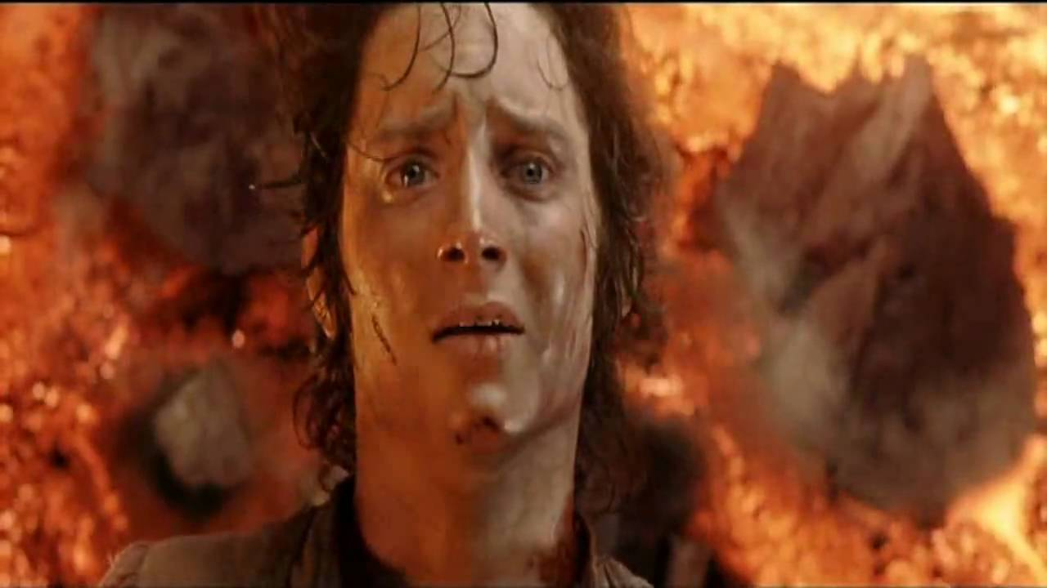
Be more Frodo
You don’t have be the world’s cleverest person
You do need to brave
You should be restless about making the world (your company) a better place
It helps having a buddy on the way
The rewards are worth it

Slide 35

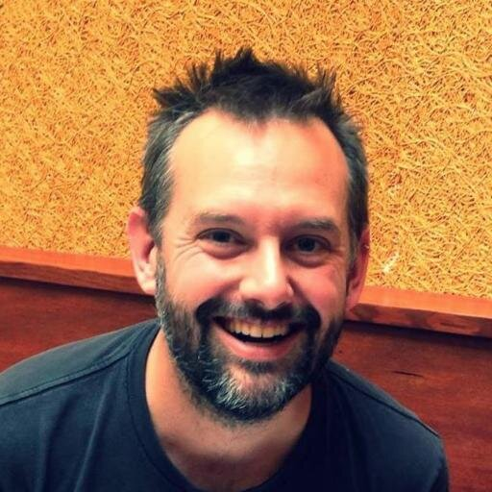
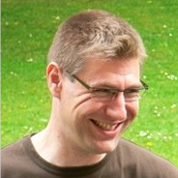

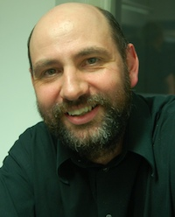
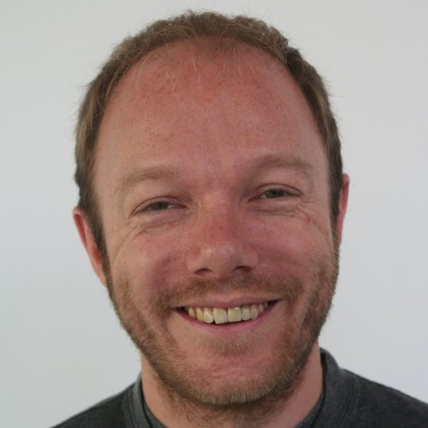
Standing on the shoulders of giants

Slide 36
Here’s the help I’m looking for: We need talented people (doesn’t everyone) Any experiences you can share of this type of cultural shift (particularly with traditional infrastructure teams) is very welcomed

